Slide 1
Discussion 9: Disjoint Sets, Trees, Hashing
Christine Zhou

Slide 2


Slide 3
Announcements
Happy (almost) Pi(e) day!
Homework 2 due tomorrow, March 14!
Homework 3 will be released
Due Monday, March 19
Midterm 2 on Tuesday, March 20
Midterm review session Friday 16th 8-10 PM
Guerrilla section Saturday 17th 12-2 PM
Resources: tinyurl.com/cs61b-christine-zhou
Attendance: https://tinyurl.com/disc9-cz

Slide 4
Disjoint Sets
Used to represent connectivity between items
Each item belongs to its own set, “union” the items together by connecting the sets together
Sets will have a tree like structure
Two basic functions: connect(a, b), isConnected(a, b)
Optimizations:
Union by weight: connect the root of the “lighter” set to the root of the “heavier” set (determined by number of nodes in the set)
Path compression: when you “find” a node, compress the node and the path to the node by connecting it to the root of the set
61BL Lab about Disjoint Sets

Slide 5
Implementations of Disjoint Sets
Quick Find
Quick Union
Weighted Quick Union

Slide 6
Quick Find
Use an array to store which set each element is in
{ 0, 1, 2, 4 }, {3, 5}, {6}
0
1
2
3
6
4
5
int[] id
0 | 0 | 0 | 3 | 0 | 3 | 6
Notes:
Talk about how connect and isConnected work

Slide 7
Quick Union
Use an array to store the parent of each node
int[] parent
0 | 0 | 1 | 3 | 0 | 3 | 6
0 1 2 3 4 5 6
0
1
3
6
4
2
5
Notes:
Talk about how connect and isConnected work

Slide 8
Weighted Quick Union
Quick Union, but always add smaller tree to larger tree
connect(3,8)
0
0
6
1
2
3
4
5
6
1
2
3
4
5
7
8
7
8
9
9

Slide 9
Disjoint Set Runtimes
Implementation | Constructor | connect | isConnected
QuickFindDS | Θ(N) | Θ(N) | Θ(1)
QuickUnionDS | Θ(N) | O(N) | O(N)
WeightedQuickUnionDS | Θ(N) | O(log N) | O(log N)

Slide 10
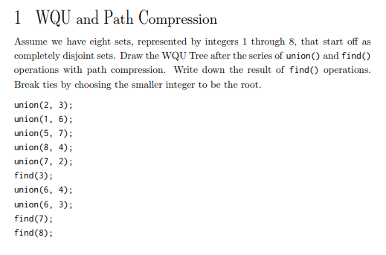
1 WQU and Path Compression

Slide 11
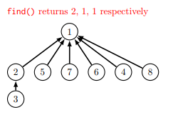
1 WQU and Path Compression

Slide 12
Binary Search Tree
Every key in the left subtree is less than X’s key
Every key in the right subtree is greater than X’s key
dog
bag
flat
alf
cat
elf
glut
Binary Search Tree

Slide 13
BST Runtimes
Shape of Tree | Height | add | search
“Bushy” (Best Case) | logN | Θ(logN) | Θ(logN)
“Spindly” (Worst Case) | N | Θ(N) | Θ(N)
Notes:
I think the search runtimes need to be best case/worst case for each tree (i.e, for a bushy tree, search is theta(log N) in the worst case)

Slide 14
2 Is This a BST?
The following method isBSTBad is supposed to check if a given binary tree is a BST, though for some binary trees, it is returning the wrong answer. Think about an example of a binary tree for which isBSTBad fails. Then, write isBSTGood so that it returns the correct answer for any binary tree. The TreeNode class is defined as follows:
class TreeNode {
Int val;
TreeNode left, right;
}
Hint: You will find Integer.MIN_VALUE and Integer.MAX_VALUE helpful with isBSTGood!

Slide 15
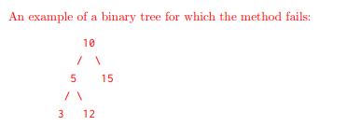

Slide 16
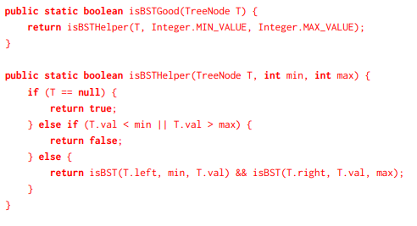

Slide 17
Balanced Search Trees
m q
e
o
s u
b
g
n
p
r
t
v
Bushy was better than spindly trees in terms of runtime
2-3 Trees!
Should still follow the BST property (less on the left, greater on the right)
Each node contains 1-2 elements with 2-3 children nodes
Maintains log(N) height of “bushy” BST’s!
If we want to insert an element, we’ll traverse and put it in the corresponding leaf node
It’s possible that it will have more than 2 elements
Split the node, and send up middle element, this can happen recursively

Slide 18
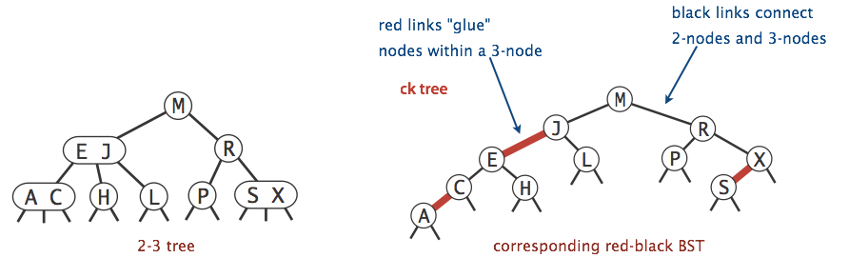
Left-Leaning Red-Black Trees
How do we implement 2-3 trees in code?
A binary tree that colors links red and black
Any red links are “glue”, meaning the two nodes are in the same 2-3 tree node

Slide 19
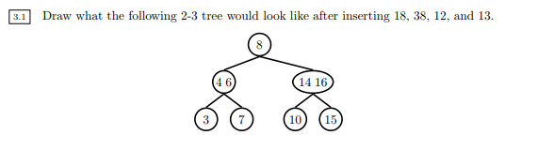
3) 2-3 Trees and LLRB’s
Draw what the following 2-3 tree would look like after inserting 18, 38, 12, and 13.

Slide 20
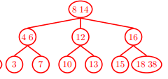

Slide 21
3) 2-3 Trees and LLRB’s
Now convert the resulting 2-3 tree to a left-leaning red-black tree.

Slide 22
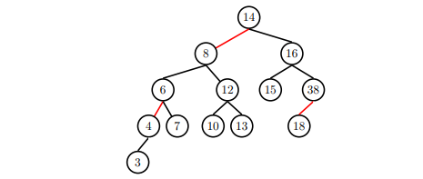

Slide 23
3) 2-3 Trees and LLRB’s
Extra: If a 2-3 tree has depth H (that is, the leaves are at distance H from the root), what is the maximum number of comparisons done in the corresponding red-black tree to find whether a certain key is present in the tree?
Hint: Think about what the longest root-to-leaf path will be!

Slide 24
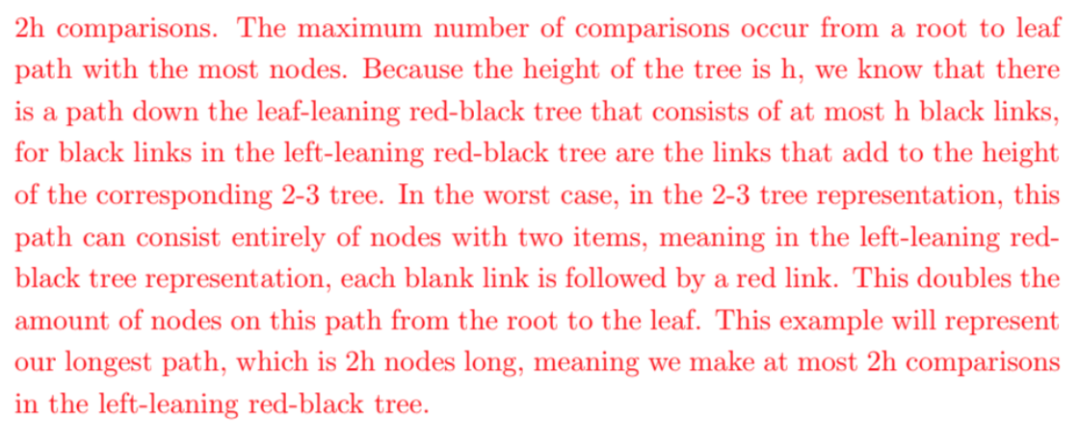
3) 2-3 Trees and LLRB’s

Slide 25
Hashing
Want to store keys with values?
Hash table has a certain amount of “buckets” to store data
Usually represented by an array
Assign each element a “hash code” and use that as your value’s index
mod (%) by number of buckets and place in that “bucket”
Careful about negative numbers!
N = num elements, M = num buckets, C = some constant
If N/M > C, then increase M!
Elements that go to same bucket will be kept track of with a list of some sort (external chaining)
What is the runtime of .contains and .insert?

Slide 26
Hashtable
Use the hashcode % array.length to index into an array
On collision, one resolution is external chaining
0
1
2
3
4
5

Slide 27
Hashing
Function that produces an integer from a Java object
Properties:
The hashcode for the same object should always be the same
If two objects are “equal”, they have the same hashcode

Slide 28
HashTable Runtimes
 | add | get | remove
Best Case | Θ(1) | Θ(1) | Θ(1)
Worst Case | Θ(N) | Θ(N) | Θ(N)

Slide 29
4 Hashing
Here are three potential implementations of the Integer’s hashCode() function. Categorize each as either a valid or an invalid hash function. If it is invalid, explain why. If it is valid, point out a flaw or disadvantage.
public int hashCode() { public int hashCode() {
return -1; return intValue() * intValue();
} }
public int hashCode() {
return super.hashCode(); }

Slide 30
